Slide 1
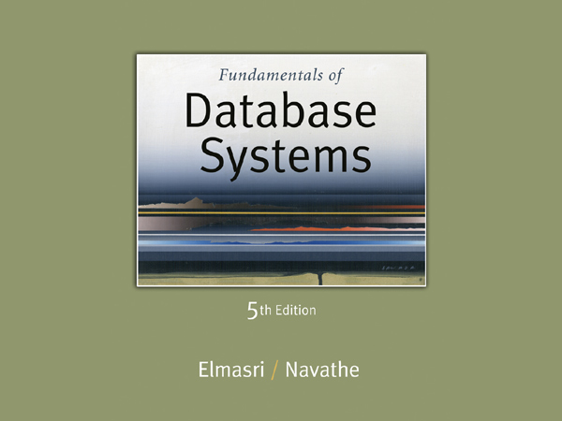

Slide 2
Chapter 15
Algorithms for Query Processing and Optimization

Slide 3
Chapter Outline (1)
0. Introduction to Query Processing
1. Translating SQL Queries into Relational Algebra
2. Algorithms for External Sorting
3. Algorithms for SELECT and JOIN Operations
4. Algorithms for PROJECT and SET Operations
5. Implementing Aggregate Operations and Outer Joins
6. Combining Operations using Pipelining
7. Using Heuristics in Query Optimization
8. Using Selectivity and Cost Estimates in Query Optimization
9. Overview of Query Optimization in Oracle
10. Semantic Query Optimization

Slide 4
0. Introduction to Query Processing (1)
Query processing
Is the list of activities that are perform to obtain the required tuples that satisfy a given query.
Query optimization:
The process of choosing a suitable execution strategy for processing a query.
Two internal representations of a query:
Query Tree
Query Graph

Slide 5
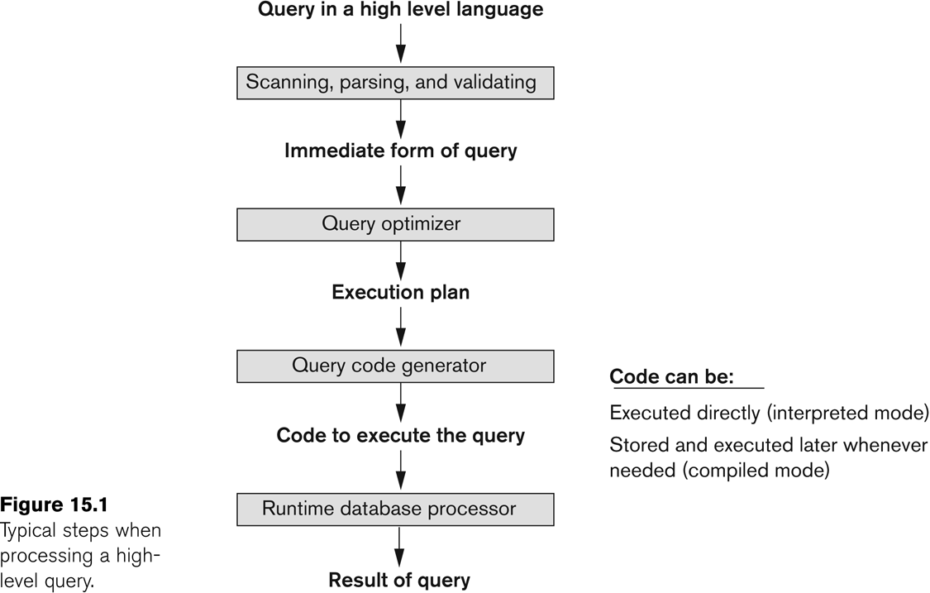
Introduction to Query Processing (2)

Slide 6
1. Translating SQL Queries into Relational Algebra
Parser & Translator:
Syntax
Schema element
Converts the query into Relation Algebra
Optimizer:
Find all equivalent Relation Algebra expressions
Find the Relation Algebra expression with least cost.
Cost (CPU, Block access, time spent)
Will create query evaluation plan which tell what algorithm is used.
Query evaluation plan:
Evaluate the above plan and get the result

Slide 7
1. Translating SQL Queries into Relational Algebra (1)
Query block:
The basic unit that can be translated into the algebraic operators and optimized.
A query block contains a single SELECT-FROM-WHERE expression, as well as GROUP BY and HAVING clause if these are part of the block.
Nested queries within a query are identified as separate query blocks.
Aggregate operators in SQL must be included in the extended algebra.

Slide 8
Translating SQL Queries into Relational Algebra (2)
SELECT LNAME, FNAME
FROM EMPLOYEE
WHERE SALARY > ( SELECT MAX (SALARY)
FROM EMPLOYEE
WHERE DNO = 5);
SELECT LNAME, FNAME
FROM EMPLOYEE
WHERE SALARY > C
SELECT MAX (SALARY)
FROM EMPLOYEE
WHERE DNO = 5
π_{LNAME, FNAME} (σ_{SALARY>C}(EMPLOYEE))
ℱ_{MAX SALARY} (σ_{DNO=5} (EMPLOYEE))

Slide 9
2. Algorithms for External Sorting (1)
External sorting:
Refers to sorting algorithms that are suitable for large files of records stored on disk that do not fit entirely in main memory, such as most database files.
Sort-Merge strategy:
Starts by sorting small subfiles (runs) of the main file and then merges the sorted runs, creating larger sorted subfiles that are merged in turn.
Sorting phase: n_{R} = ⎡(b/n_{B})⎤
Merging phase: d_{M} = Min (n_{B}-1, n_{R}); n_{P} = ⎡(log_{dM}(n_{R}))⎤
n_{R}: number of initial runs; b: number of file blocks;
n_{B}: available buffer space; d_{M}: degree of merging;
n_{P}: number of passes.

Slide 10
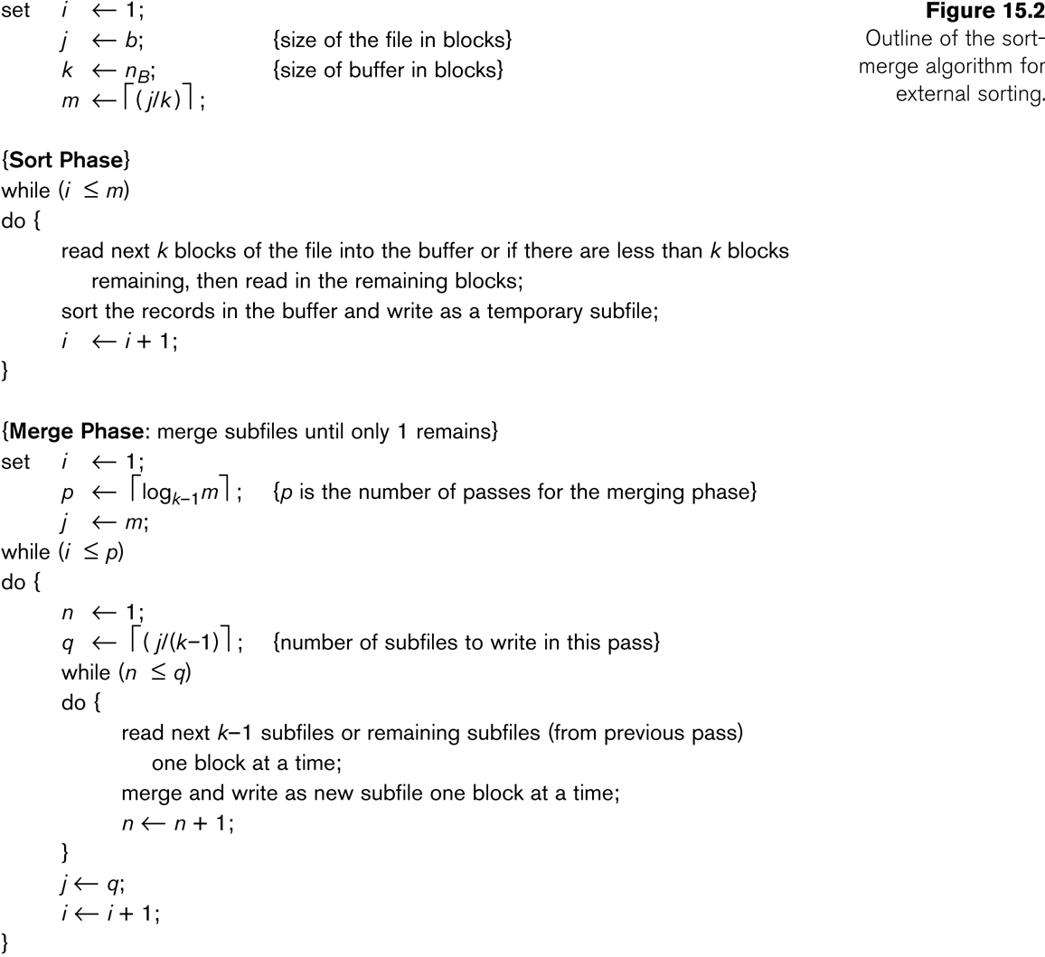
Fig: Outline of sort-merge algorithm for external sorting

Slide 11
Fig: Outline of sort-merge algorithm for external sorting

Slide 12
3. Algorithms for SELECT and JOIN Operations (1)
Implementing the SELECT Operation
Examples:
(OP1): σ _{SSN='123456789'} (EMPLOYEE)
(OP2): σ _{DNUMBER>5}(DEPARTMENT)
(OP3): σ _{DNO=5}(EMPLOYEE)
(OP4): σ DNO=5 AND SALARY>30000 AND SEX=‘F’(EMPLOYEE)
(OP5): σ _{ESSN=123456789 AND PNO=10}(WORKS_ON)

Slide 13
Algorithms for SELECT and JOIN Operations (2)
Implementing the SELECT Operation (contd.):
Search Methods for Simple Selection:
S1 Linear search (brute force):
Retrieve every record in the file, and test whether its attribute values satisfy the selection condition.
S2 Binary search:
If the selection condition involves an equality comparison on a key attribute on which the file is ordered, binary search (which is more efficient than linear search) can be used. (See OP1).
S3 Using a primary index or hash key to retrieve a single record:
If the selection condition involves an equality comparison on a key attribute with a primary index (or a hash key), use the primary index (or the hash key) to retrieve the record.

Slide 14
Algorithms for SELECT and JOIN Operations (3)
Implementing the SELECT Operation (contd.):
Search Methods for Simple Selection:
S4 Using a primary index to retrieve multiple records:
If the comparison condition is >, ≥, <, or ≤ on a key field with a primary index, use the index to find the record satisfying the corresponding equality condition, then retrieve all subsequent records in the (ordered) file.
S5 Using a clustering index to retrieve multiple records:
If the selection condition involves an equality comparison on a non-key attribute with a clustering index, use the clustering index to retrieve all the records satisfying the selection condition.
S6 Using a secondary (B+-tree) index:
On an equality comparison, this search method can be used to retrieve a single record if the indexing field has unique values (is a key) or to retrieve multiple records if the indexing field is not a key.
In addition, it can be used to retrieve records on conditions involving >,>=, <, or <=. (FOR RANGE QUERIES)

Slide 15
Algorithms for SELECT and JOIN Operations (4)
Implementing the SELECT Operation (contd.):
Search Methods for Simple Selection:
S7 Conjunctive selection:
If an attribute involved in any single simple condition in the conjunctive condition has an access path that permits the use of one of the methods S2 to S6, use that condition to retrieve the records and then check whether each retrieved record satisfies the remaining simple conditions in the conjunctive condition.
S8 Conjunctive selection using a composite index
If two or more attributes are involved in equality conditions in the conjunctive condition and a composite index (or hash structure) exists on the combined field, we can use the index directly.

Slide 16
Algorithms for SELECT and JOIN Operations (5)
Implementing the SELECT Operation (contd.):
Search Methods for Complex Selection:
S9 Conjunctive selection by intersection of record pointers:
This method is possible if secondary indexes are available on all (or some of) the fields involved in equality comparison conditions in the conjunctive condition and if the indexes include record pointers (rather than block pointers).
Each index can be used to retrieve the record pointers that satisfy the individual condition.
The intersection of these sets of record pointers gives the record pointers that satisfy the conjunctive condition, which are then used to retrieve those records directly.
If only some of the conditions have secondary indexes, each retrieved record is further tested to determine whether it satisfies the remaining conditions.

Slide 17
Algorithms for SELECT and JOIN Operations (7)
Implementing the SELECT Operation (contd.):
Whenever a single condition specifies the selection, we can only check whether an access path exists on the attribute involved in that condition.
If an access path exists, the method corresponding to that access path is used; otherwise, the “brute force” linear search approach of method S1 is used. (See OP1, OP2 and OP3)
For conjunctive selection conditions, whenever more than one of the attributes involved in the conditions have an access path, query optimization should be done to choose the access path that retrieves the fewest records in the most efficient way.
Disjunctive selection conditions
(OP4’): σ DNO=5 OR SALARY>30000 OR SEX=‘F’(EMPLOYEE)

Slide 18
Algorithms for SELECT and JOIN Operations (8)
Implementing the JOIN Operation:
Join (EQUIJOIN, NATURAL JOIN)
two–way join: a join on two files
e.g. R _{A=B} S
multi-way joins: joins involving more than two files.
e.g. R _{A=B} S _{C=D} T
Examples
(OP6): EMPLOYEE _{DNO=DNUMBER} DEPARTMENT
(OP7): DEPARTMENT _{MGRSSN=SSN} EMPLOYEE

Slide 19
Algorithms for SELECT and JOIN Operations (9)
Implementing the JOIN Operation (contd.):
Methods for implementing joins:
J1 Nested-loop join (brute force):
For each record t in R (outer loop), retrieve every record s from S (inner loop) and test whether the two records satisfy the join condition t[A] = s[B].
J2 Single-loop join (Using an access structure to retrieve the matching records):
If an index (or hash key) exists for one of the two join attributes — say, B of S — retrieve each record t in R, one at a time, and then use the access structure to retrieve directly all matching records s from S that satisfy s[B] = t[A].

Slide 20
Algorithms for SELECT and JOIN Operations (10)
Implementing the JOIN Operation (contd.):
Methods for implementing joins:
J3 Sort-merge join:
If the records of R and S are physically sorted (ordered) by value of the join attributes A and B, respectively, we can implement the join in the most efficient way possible.
Both files are scanned in order of the join attributes, matching the records that have the same values for A and B.
In this method, the records of each file are scanned only once each for matching with the other file—unless both A and B are non-key attributes, in which case the method needs to be modified slightly.

Slide 21
Algorithms for SELECT and JOIN Operations (11)
Implementing the JOIN Operation (contd.):
Methods for implementing joins:
J4 Hash-join:
The records of files R and S are both hashed to the same hash file, using the same hashing function on the join attributes A of R and B of S as hash keys.
A single pass through the file with fewer records (say, R) hashes its records to the hash file buckets.
A single pass through the other file (S) then hashes each of its records to the appropriate bucket, where the record is combined with all matching records from R.

Slide 22
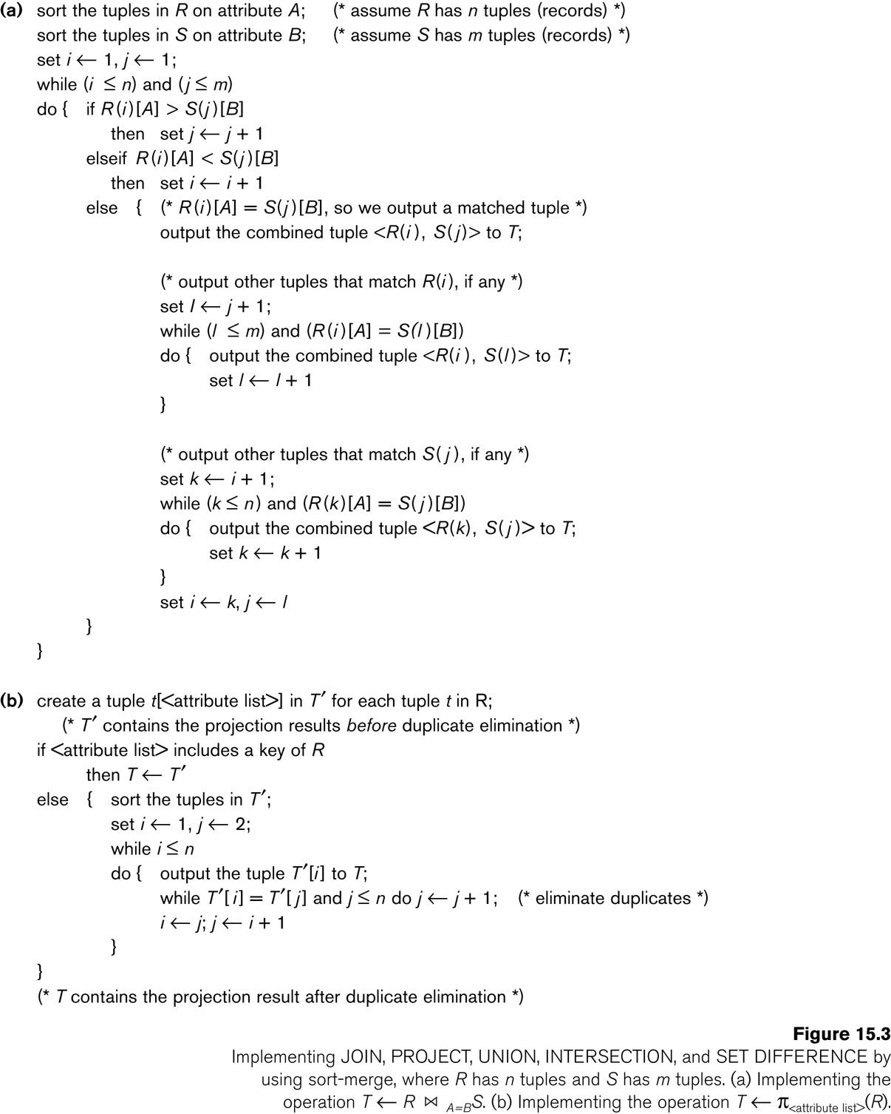
Implementation of JOIN

Slide 23
Implementation of PROJECT

Slide 24
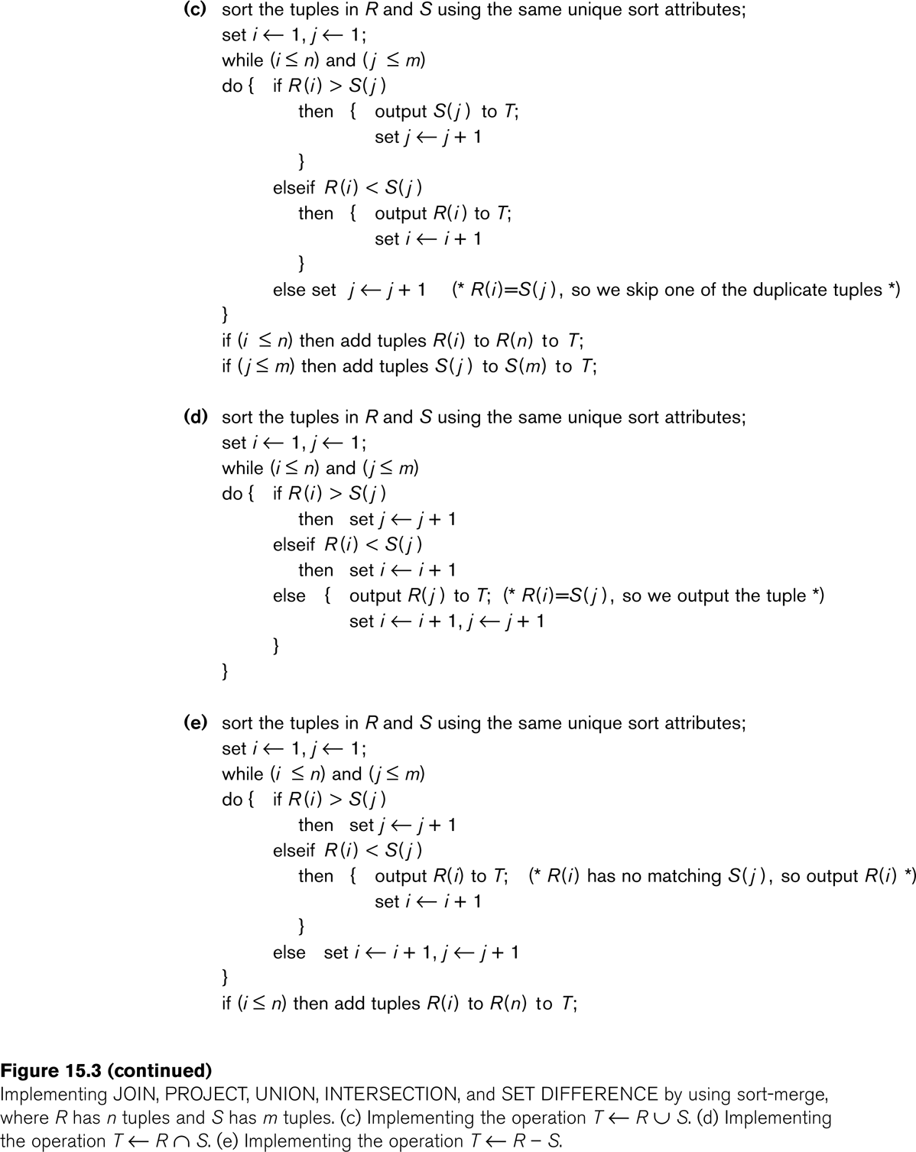
Implementation of UNION

Slide 25
Implementation of INTERSECTION

Slide 26
Implementation of SET DIFFERENCE

Slide 27
Algorithms for SELECT and JOIN Operations (14)
Implementing the JOIN Operation (contd.):
Factors affecting JOIN performance
Available buffer space
Join selection factor
Choice of inner VS outer relation

Slide 28
Algorithms for SELECT and JOIN Operations (15)
Implementing the JOIN Operation (contd.):
Other types of JOIN algorithms
Partition hash join
Partitioning phase:
Each file (R and S) is first partitioned into M partitions using a partitioning hash function on the join attributes:
R1 , R2 , R3 , ...... Rm and S1 , S2 , S3 , ...... Sm
Minimum number of in-memory buffers needed for the partitioning phase: M+1.
A disk sub-file is created per partition to store the tuples for that partition.
Joining or probing phase:
Involves M iterations, one per partitioned file.
Iteration i involves joining partitions Ri and Si.

Slide 29
Algorithms for SELECT and JOIN Operations (16)
Implementing the JOIN Operation (contd.):
Partitioned Hash Join Procedure:
Assume Ri is smaller than Si.
Copy records from Ri into memory buffers.
Read all blocks from Si, one at a time and each record from Si is used to probe for a matching record(s) from partition Si.
Write matching record from Ri after joining to the record from Si into the result file.

Slide 30
Algorithms for SELECT and JOIN Operations (17)
Implementing the JOIN Operation (contd.):
Cost analysis of partition hash join:
Reading and writing each record from R and S during the partitioning phase: (b_{R} + b_{S}), (b_{R} + b_{S})
Reading each record during the joining phase: (b_{R} + b_{S})
Writing the result of join: b_{RES}
Total Cost:
3* (b_{R} + b_{S}) + b_{RES}

Slide 31
Algorithms for SELECT and JOIN Operations (18)
Implementing the JOIN Operation (contd.):
Hybrid hash join:
Same as partitioned hash join except:
Joining phase of one of the partitions is included during the partitioning phase.
Partitioning phase:
Allocate buffers for smaller relation- one block for each of the M-1 partitions, remaining blocks to partition 1.
Repeat for the larger relation in the pass through S.)
Joining phase:
M-1 iterations are needed for the partitions R2 , R3 , R4 , ......Rm and S2 , S3 , S4 , ......Sm. R1 and S1 are joined during the partitioning of S1, and results of joining R1 and S1 are already written to the disk by the end of partitioning phase.

Slide 32
4. Algorithms for PROJECT and SET Operations (1)
Algorithm for PROJECT operations (Figure 15.3b)
π _{<attribute list>}(R)
If <attribute list> has a key of relation R, extract all tuples from R with only the values for the attributes in <attribute list>.
If <attribute list> does NOT include a key of relation R, duplicated tuples must be removed from the results.
Methods to remove duplicate tuples
Sorting
Hashing

Slide 33
Algorithms for PROJECT and SET Operations (2)
Algorithm for SET operations
Set operations:
UNION, INTERSECTION, SET DIFFERENCE and CARTESIAN PRODUCT
CARTESIAN PRODUCT of relations R and S include all possible combinations of records from R and S. The attribute of the result include all attributes of R and S.
Cost analysis of CARTESIAN PRODUCT
If R has n records and j attributes and S has m records and k attributes, the result relation will have n*m records and j+k attributes.
CARTESIAN PRODUCT operation is very expensive and should be avoided if possible.

Slide 34
Algorithms for PROJECT and SET Operations (3)
Algorithm for SET operations (contd.)
UNION (See Figure 15.3c)
Sort the two relations on the same attributes.
Scan and merge both sorted files concurrently, whenever the same tuple exists in both relations, only one is kept in the merged results.
INTERSECTION (See Figure 15.3d)
Sort the two relations on the same attributes.
Scan and merge both sorted files concurrently, keep in the merged results only those tuples that appear in both relations.
SET DIFFERENCE R-S (See Figure 15.3e)
Keep in the merged results only those tuples that appear in relation R but not in relation S.

Slide 35
5. Implementing Aggregate Operations and Outer Joins (1)
Implementing Aggregate Operations:
Aggregate operators:
MIN, MAX, SUM, COUNT and AVG
Options to implement aggregate operators:
Table Scan
Index
Example
SELECT MAX (SALARY)
FROM EMPLOYEE;
If an (ascending) index on SALARY exists for the employee relation, then the optimizer could decide on traversing the index for the largest value, which would entail following the right most pointer in each index node from the root to a leaf.

Slide 36
Implementing Aggregate Operations and Outer Joins (2)
Implementing Aggregate Operations (contd.):
SUM, COUNT and AVG
For a dense index (each record has one index entry):
Apply the associated computation to the values in the index.
For a non-dense index:
Actual number of records associated with each index entry must be accounted for
With GROUP BY: the aggregate operator must be applied separately to each group of tuples.
Use sorting or hashing on the group attributes to partition the file into the appropriate groups;
Computes the aggregate function for the tuples in each group.
What if we have Clustering index on the grouping attributes?

Slide 37
Implementing Aggregate Operations and Outer Joins (3)
Implementing Outer Join:
Outer Join Operators:
LEFT OUTER JOIN
RIGHT OUTER JOIN
FULL OUTER JOIN.
The full outer join produces a result which is equivalent to the union of the results of the left and right outer joins.
Example:
SELECT FNAME, DNAME
FROM (EMPLOYEE LEFT OUTER JOIN DEPARTMENT
ON DNO = DNUMBER);
Note: The result of this query is a table of employee names and their associated departments. It is similar to a regular join result, with the exception that if an employee does not have an associated department, the employee's name will still appear in the resulting table, although the department name would be indicated as null.

Slide 38
Implementing Aggregate Operations and Outer Joins (4)
Implementing Outer Join (contd.):
Modifying Join Algorithms:
Nested Loop or Sort-Merge joins can be modified to implement outer join. E.g.,
For left outer join, use the left relation as outer relation and construct result from every tuple in the left relation.
If there is a match, the concatenated tuple is saved in the result.
However, if an outer tuple does not match, then the tuple is still included in the result but is padded with a null value(s).

Slide 39
Implementing Aggregate Operations and Outer Joins (5)
Implementing Outer Join (contd.):
Executing a combination of relational algebra operators.
Implement the previous left outer join example
{Compute the JOIN of the EMPLOYEE and DEPARTMENT tables}
TEMP1π_{FNAME,DNAME}(EMPLOYEE _{DNO=DNUMBER} DEPARTMENT)
{Find the EMPLOYEEs that do not appear in the JOIN}
TEMP2  π _{FNAME} (EMPLOYEE) - π_{FNAME} (Temp1)
{Pad each tuple in TEMP2 with a null DNAME field}
TEMP2  TEMP2 x 'null'
{UNION the temporary tables to produce the LEFT OUTER JOIN}
RESULT  TEMP1 υ TEMP2
The cost of the outer join, as computed above, would include the cost of the associated steps (i.e., join, projections and union).

Slide 40
6. Combining Operations using Pipelining (1)
Motivation
A query is mapped into a sequence of operations.
Each execution of an operation produces a temporary result.
Generating and saving temporary files on disk is time consuming and expensive.
Alternative:
Avoid constructing temporary results as much as possible.
Pipeline the data through multiple operations - pass the result of a previous operator to the next without waiting to complete the previous operation.

Slide 41
Combining Operations using Pipelining (2)
Example:
For a 2-way join, combine the 2 selections on the input and one projection on the output with the Join.
Dynamic generation of code to allow for multiple operations to be pipelined.
Results of a select operation are fed in a "Pipeline" to the join algorithm.
Also known as stream-based processing.

Slide 42
7. Using Heuristics in Query Optimization(1)
Process for heuristics optimization
The parser of a high-level query generates an initial internal representation;
Apply heuristics rules to optimize the internal representation.
A query execution plan is generated to execute groups of operations based on the access paths available on the files involved in the query.
The main heuristic is to apply first the operations that reduce the size of intermediate results.
E.g., Apply SELECT and PROJECT operations before applying the JOIN or other binary operations.

Slide 43
Using Heuristics in Query Optimization (2)
Query tree:
A tree data structure that corresponds to a relational algebra expression. It represents the input relations of the query as leaf nodes of the tree, and represents the relational algebra operations as internal nodes.
An execution of the query tree consists of executing an internal node operation whenever its operands are available and then replacing that internal node by the relation that results from executing the operation.
Query graph:
A graph data structure that corresponds to a relational calculus expression. It does not indicate an order on which operations to perform first. There is only a single graph corresponding to each query.

Slide 44
Using Heuristics in Query Optimization (3)
Example:
For every project located in ‘Stafford’, retrieve the project number, the controlling department number and the department manager’s last name, address and birthdate.
Relation algebra:
πPNUMBER, DNUM, LNAME, ADDRESS, BDATE (((σ_{PLOCATION=‘STAFFORD’}(PROJECT)) _{DNUM=DNUMBER} (DEPARTMENT)) _{MGRSSN=SSN} (EMPLOYEE))
SQL query:
Q2: SELECT P.NUMBER,P.DNUM,E.LNAME, E.ADDRESS, E.BDATE
FROM PROJECT AS P,DEPARTMENT AS D, EMPLOYEE AS E
WHERE P.DNUM=D.DNUMBER AND D.MGRSSN=E.SSN AND P.PLOCATION=‘STAFFORD’;

Slide 45
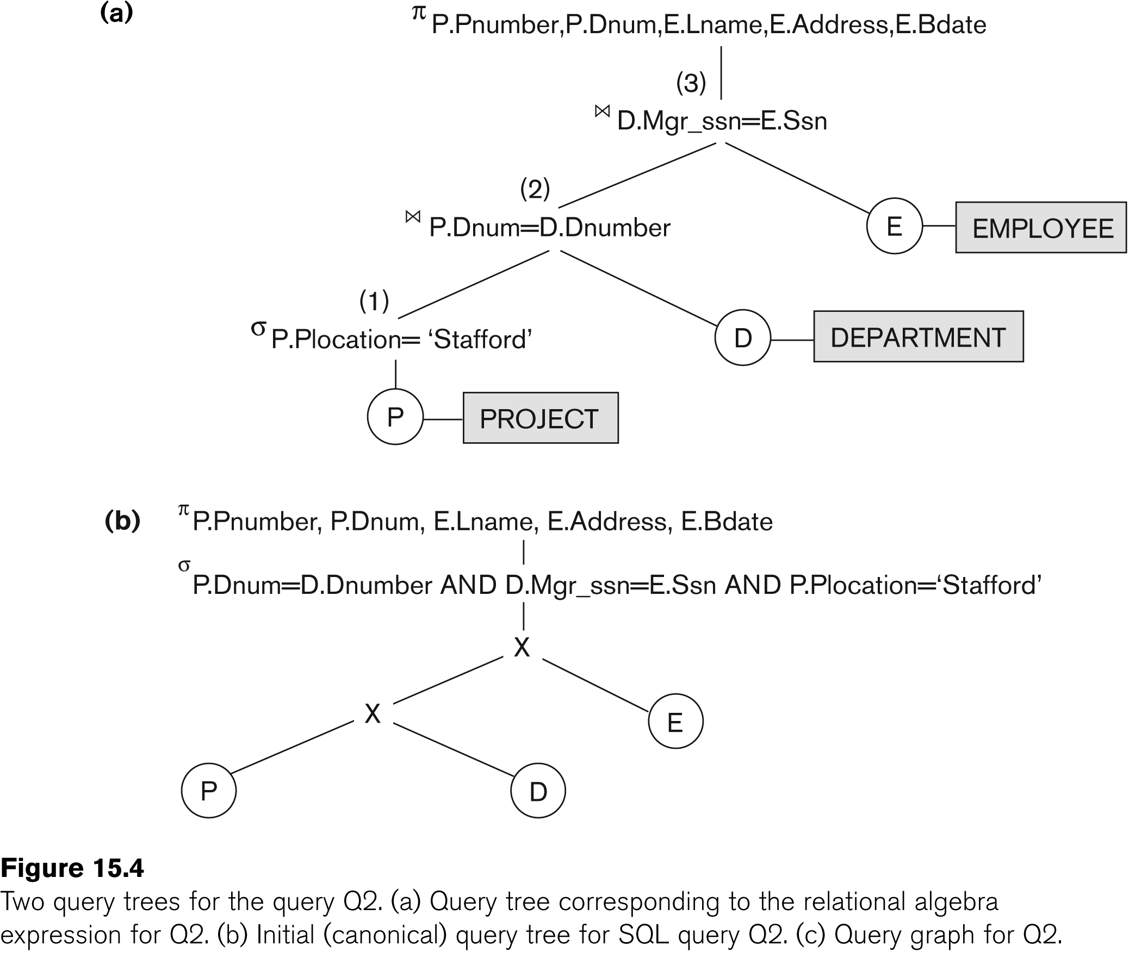
Using Heuristics in Query Optimization (4)

Slide 46
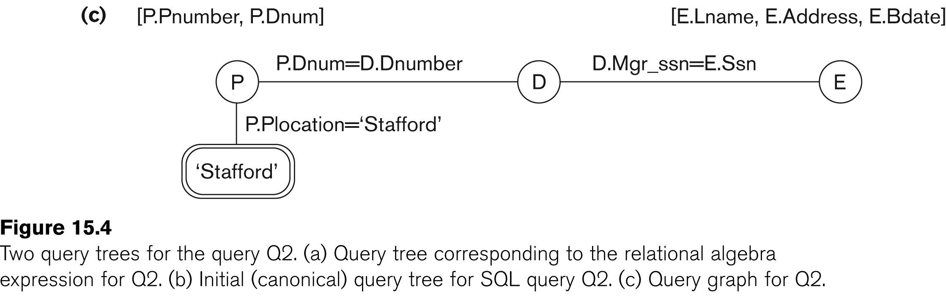
Using Heuristics in Query Optimization (5)

Slide 47
Using Heuristics in Query Optimization (6)
Heuristic Optimization of Query Trees:
The same query could correspond to many different relational algebra expressions — and hence many different query trees.
The task of heuristic optimization of query trees is to find a final query tree that is efficient to execute.
Example:
Q: SELECT LNAME
FROM EMPLOYEE, WORKS_ON, PROJECT
WHERE PNAME = ‘AQUARIUS’ AND PNMUBER=PNO AND ESSN=SSN AND BDATE > ‘1957-12-31’;

Slide 48
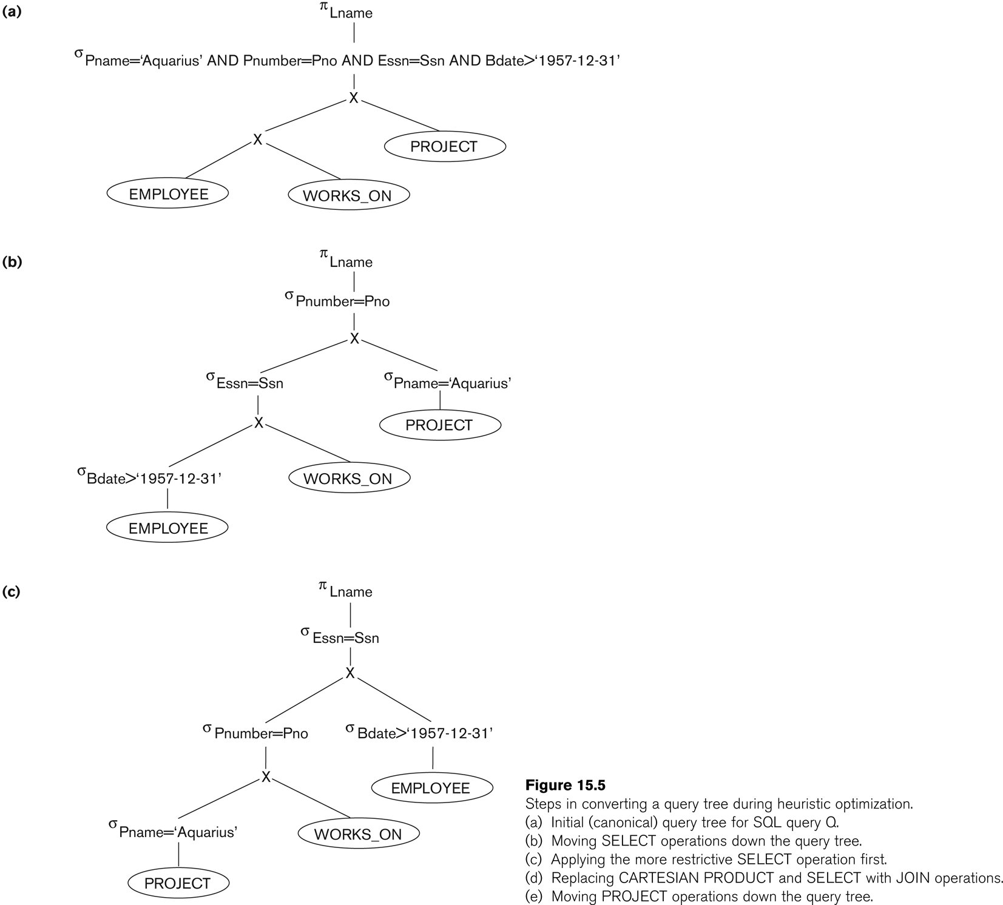
Using Heuristics in Query Optimization (7)

Slide 49
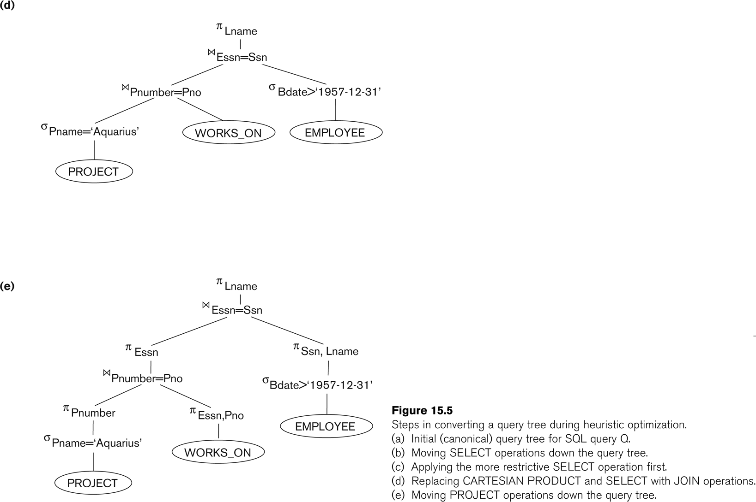
Using Heuristics in Query Optimization (8)

Slide 50
Using Heuristics in Query Optimization (9)
General Transformation Rules for Relational Algebra Operations:
1. Cascade of σ: A conjunctive selection condition can be broken up into a cascade (sequence) of individual σ operations:
σ _{c1 AND c2 AND ... AND cn}(R) = σ_{c1} (σ_{c2} (...(σ_{cn}(R))...) )
2. Commutativity of σ: The σ operation is commutative:
σ_{c1} (σ_{c2}(R)) = σ_{c2} (σ_{c1}(R))
3. Cascade of π: In a cascade (sequence) of π operations, all but the last one can be ignored:
π_{List1} (π_{List2} (...(π_{Listn}(R))...) ) = π_{List1}(R)
4. Commuting σ with π: If the selection condition c involves only the attributes A1, ..., An in the projection list, the two operations can be commuted:
π_{A1, A2, ..., An} (σ_{c} (R)) = σ_{c} (π_{A1, A2, ..., An} (R))

Slide 51
Using Heuristics in Query Optimization (10)
General Transformation Rules for Relational Algebra Operations (contd.):
5. Commutativity of ( and x ): The operation is commutative as is the x operation:
R _{C} S = S _{C} R; R x S = S x R
6. Commuting σ with (or x ): If all the attributes in the selection condition c involve only the attributes of one of the relations being joined—say, R—the two operations can be commuted as follows:
σ_{c} ( R S ) = (σ_{c} (R)) S
Alternatively, if the selection condition c can be written as (c1 and c2), where condition c1 involves only the attributes of R and condition c2 involves only the attributes of S, the operations commute as follows:
σ_{c} ( R S ) = (σ_{c1} (R)) (σ_{c2} (S))

Slide 52
Using Heuristics in Query Optimization (11)
General Transformation Rules for Relational Algebra Operations (contd.):
7. Commuting π with (or x): Suppose that the projection list is L = {A1, ..., An, B1, ..., Bm}, where A1, ..., An are attributes of R and B1, ..., Bm are attributes of S. If the join condition c involves only attributes in L, the two operations can be commuted as follows:
π_{L} ( R _{C} S ) = (π_{A1, ..., An} (R)) _{C} (π _{B1, ..., Bm} (S))
If the join condition C contains additional attributes not in L, these must be added to the projection list, and a final π operation is needed.

Slide 53
Using Heuristics in Query Optimization (12)
General Transformation Rules for Relational Algebra Operations (contd.):
8. Commutativity of set operations: The set operations υ and ∩ are commutative but “–” is not.
9. Associativity of , x, υ, and ∩ : These four operations are individually associative; that is, if θ stands for any one of these four operations (throughout the expression), we have
( R θ S ) θ T = R θ ( S θ T )
10. Commuting σ with set operations: The σ operation commutes with υ , ∩ , and –. If θ stands for any one of these three operations, we have
σ_{c} ( R θ S ) = (σ_{c} (R)) θ (σ_{c} (S))

Slide 54
Using Heuristics in Query Optimization (13)
General Transformation Rules for Relational Algebra Operations (contd.):
The π operation commutes with υ. π_{L} ( R υ S ) = (π_{L} (R)) υ (π_{L} (S))
Converting a (σ, x) sequence into : If the condition c of a σ that follows a x Corresponds to a join condition, convert the (σ, x) sequence into a as follows: (σ_{C} (R x S)) = (R _{C} S)
Other transformations

Slide 55
Using Heuristics in Query Optimization (14)
Outline of a Heuristic Algebraic Optimization Algorithm:
Using rule 1, break up any select operations with conjunctive conditions into a cascade of select operations.
Using rules 2, 4, 6, and 10 concerning the commutativity of select with other operations, move each select operation as far down the query tree as is permitted by the attributes involved in the select condition.
Using rule 9 concerning associativity of binary operations, rearrange the leaf nodes of the tree so that the leaf node relations with the most restrictive select operations are executed first in the query tree representation.
Using Rule 12, combine a Cartesian product operation with a subsequent select operation in the tree into a join operation.
Using rules 3, 4, 7, and 11 concerning the cascading of project and the commuting of project with other operations, break down and move lists of projection attributes down the tree as far as possible by creating new project operations as needed.
Identify subtrees that represent groups of operations that can be executed by a single algorithm.

Slide 56
Using Heuristics in Query Optimization (15)
Summary of Heuristics for Algebraic Optimization:
The main heuristic is to apply first the operations that reduce the size of intermediate results.
Perform select operations as early as possible to reduce the number of tuples and perform project operations as early as possible to reduce the number of attributes. (This is done by moving select and project operations as far down the tree as possible.)
The select and join operations that are most restrictive should be executed before other similar operations. (This is done by reordering the leaf nodes of the tree among themselves and adjusting the rest of the tree appropriately.)

Slide 57
Using Heuristics in Query Optimization (16)
Query Execution Plans
An execution plan for a relational algebra query consists of a combination of the relational algebra query tree and information about the access methods to be used for each relation as well as the methods to be used in computing the relational operators stored in the tree.
Materialized evaluation: the result of an operation is stored as a temporary relation.
Pipelined evaluation: as the result of an operator is produced, it is forwarded to the next operator in sequence.

Slide 58
Summary
0. Introduction to Query Processing
1. Translating SQL Queries into Relational Algebra
2. Algorithms for External Sorting
3. Algorithms for SELECT and JOIN Operations
4. Algorithms for PROJECT and SET Operations
5. Implementing Aggregate Operations and Outer Joins
6. Combining Operations using Pipelining
7. Using Heuristics in Query Optimization

